Slide 1

CPE 301 Project Presentation
Air Particulate Sensor POD v2
Jason Sikorski
sikorsk4@unlv.nevada.edu

Slide 2
AIM & ACCOMPLISHMENTS
AIM:
Create a sensor package that can be used to monitor air quality
Store sensor data directly on SD card
Store sensor data remotely on an IoT cloud server
Display data using a web app interface
ACCOMPLISHMENTS
Sensor package was developed using 4 gas sensors, temperature sensor, GPS module, radio transmitter and SD card reader.
Modules were interfaced using ADC, SPI and UART interfaces.
Cloud storage was implemented using IBM Watson servers
Web App Interface was implemented using Intel Edison

Slide 3
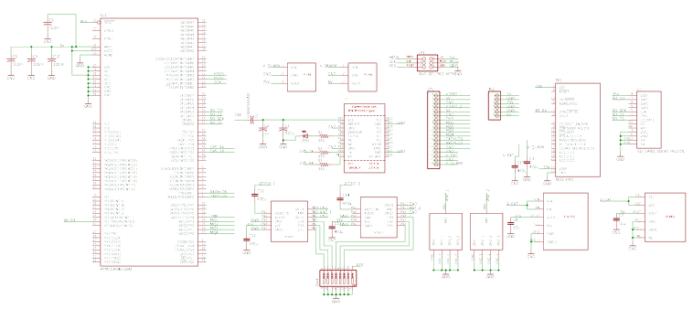
SCHEMATICS

Slide 4
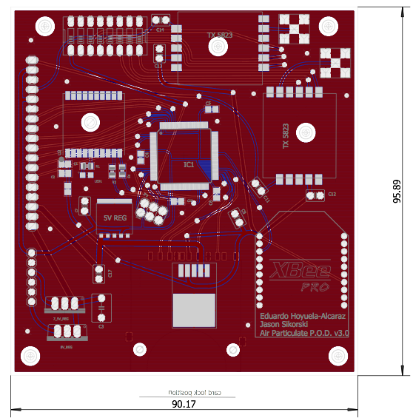
PCB Layout

Slide 5

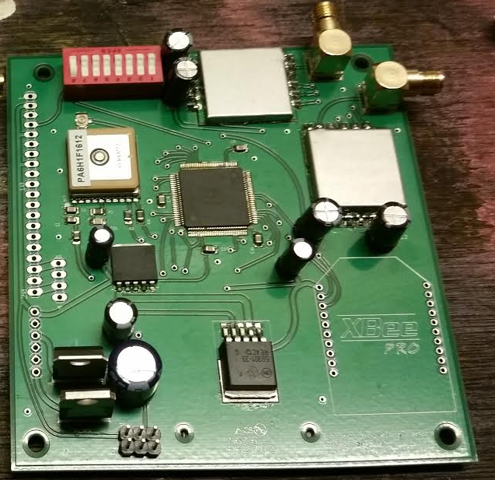
FINAL PCB

Slide 6
DESIGN STAGES
Components
AVR ATmega2560 - Microcontroller unit (MCU)
MQ 2 - Analog Propane gas sensor
MQ 5 - Analog Methane gas sensor
MQ 7 - Analog Carbon Monoxide gas sensor
MQ 136 - Analog Hydrogen Sulfide gas sensor
TMP 136 - Analog Temperature sensor
MTK3339 GPS Module
Dylos DC1700 Air Particulate sensor
SD Card
XBee S3B 900MHz radio transmitter
Intel Edison

Slide 7
DESIGN STAGES
Interfaces
ATmega2560 — MQ 2, MQ 5, MQ 7, MQ 136, TMP 136 — Analog to Digital Converter (ADC)
ATmega2560 — MTK3339, DC1700, XBee S3B — Universal Asynchronous Receiver/Transmitter (UART)
ATmega2560 — SD Card — Serial Peripheral Interface (SPI)
XBee S3B — Intel Edison — Universal Asynchronous Receiver/Transmitter (UART)
Web Hosting
Web App hosted by Intel Edison written in JavaScript
MQTT transmission of data using JSON package to IBM Watson cloud written in JavaScript

Slide 8
CODE DEVELOPMENT
Initialization
Initialize USART 0, 1, 2, 3
Set Timer 1 for 1 sec duty cycle
Mount SD Card/Open Write File
Enable Interrupts
Data Collection
Parse Dylos line
Parse GPS line
Call functions to read analog sensors
Construct String for SD card & radio transmit
Write to SD card
Send Data to XBee radio transmitter
Visualization
Website hosted by Intel Edison
IBM Watson cloud storage

Slide 9
data interpretation
Dylos dc 1700
Transmit string format:
15, 67
MTK3339 GPS Module
Transmit string format:
$GPRMC,123519,A,4807.038,N,01131.000,E,022.4,084.4,230394,003.1,W*6A
$GPGGA,123519,4807.038,N,01131.000,E,1,08,0.9,545.4,M,46.9,M,,*47
MQ Gas sensors
Logarithmic chart: Resistance vs ppm
Solve for resistance using a voltage divider circuit with calculated ADC voltage and known load resistance.
Solve logarithmic function — RS = k ppm^{m}
Look up resistance value in a look up table.
Temperature sensor
ADC conversion — ℃ = x mv - 50

Slide 10
Video demonstration
Demo Link

